Slide 1

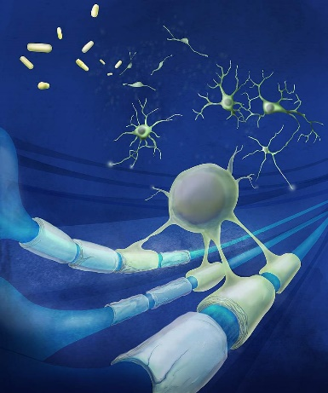
Targeting Acid-Sensing Ion Channels:
A Novel Strategy for Treating Neurodegeneration in Multiple Sclerosis (MS)
Dr. Nemat Khan
Assistant Professor
Department of Medical Sciences
Khalifa University
Abu Dhabi, UAE

Slide 2
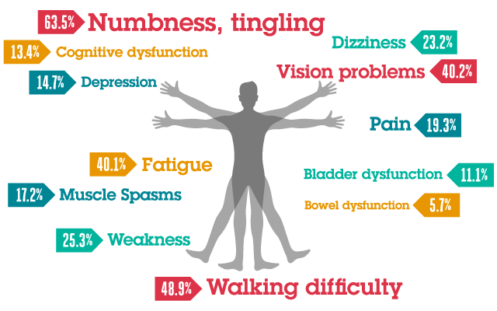
Multiple sclerosis (MS)
A chronic inflammatory demyelinating disease of CNS
Affects young adults (20-40 years). This disease is affecting at least ~3 million people globally (Female: Male = 3:1).
Precise etiology is unknown. The most widely accepted theory is that it is an autoimmune disease induced by viral infectious agents (most likely Epstein–Barr virus (EBV)). Other risk factors include low Vitamin D, smoking and genetic susceptibility.
Manifests a wide range of neurological symptoms

Slide 3
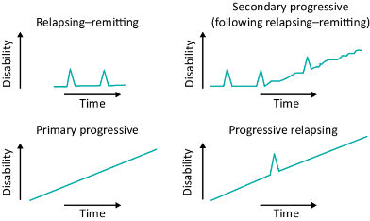
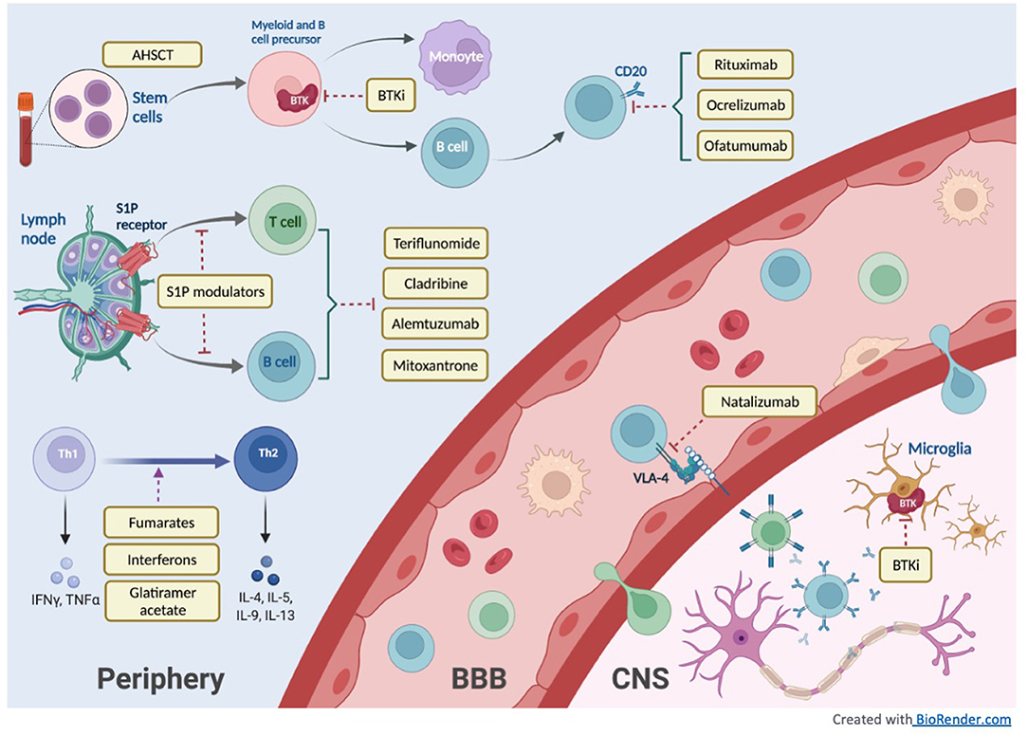
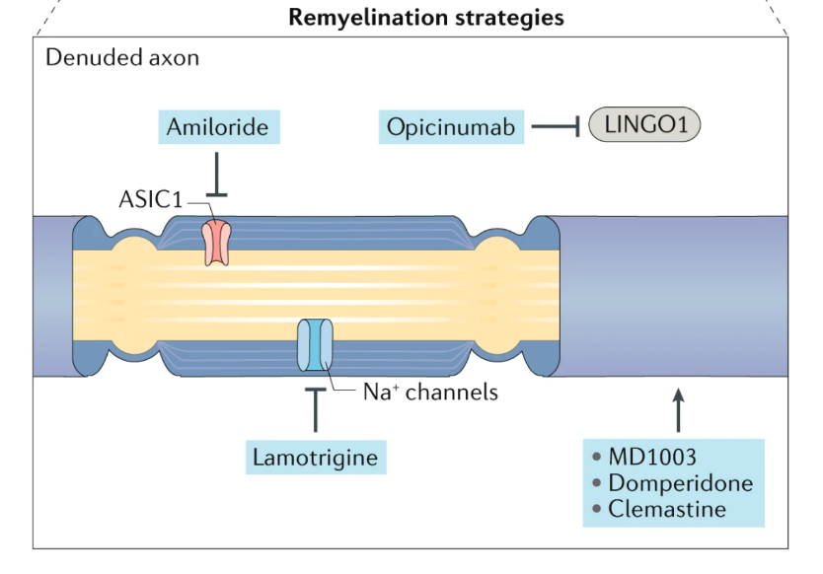
MS Pathogenesis, current DMTs – Where is the gap?
The majority of approved drugs for MS primarily target immune cells.
Need to develop remyelination therapies
Amiloride is a universal blocker for ASICs and many other ion channels, such as ENaCs
Yang JH et al., Front Neurol, 2022

Slide 4
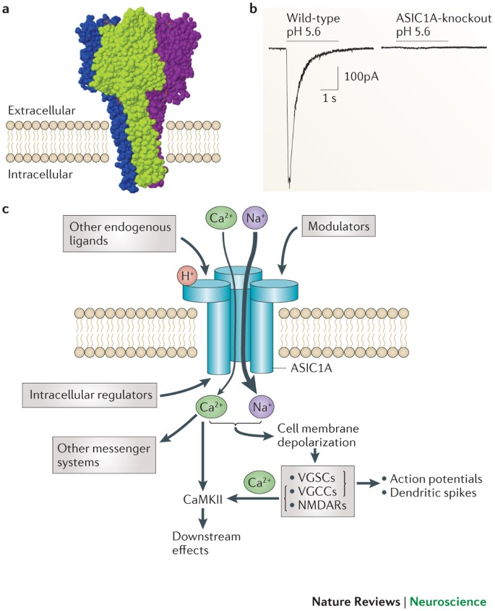


Acid-sensing ion channels (ASICs): Role in MS?
ASICs are activated by low extracellular pH; 6 subtypes (1a, 1b, 2a, 2b, 3, 4)
1st report of ASICs in MS.
EAE mouse model and in-vitro studies show that
Amiloride / ASIC1^{-/-} mice were neuroprotective
2007, Friese et al.
ASIC1 was upregulated in axons and oligodendrocytes within lesions from EAE mice and from patients with active multiple sclerosis
2011, Vergo et al.
Amiloride failed in phase 2b, multi-arm, double-blind, randomised placebo-controlled trial
2020, Chataway et al.
Wemmie, J et al. 2013. Nat Rev Neurosci
Notes:
https://www.nature.com/articles/nrn3529 | Amiloride is a universal blocker for ASICs and many other ion channels, such as ENaCs and sodium/hydrogen exchangers .

Slide 5


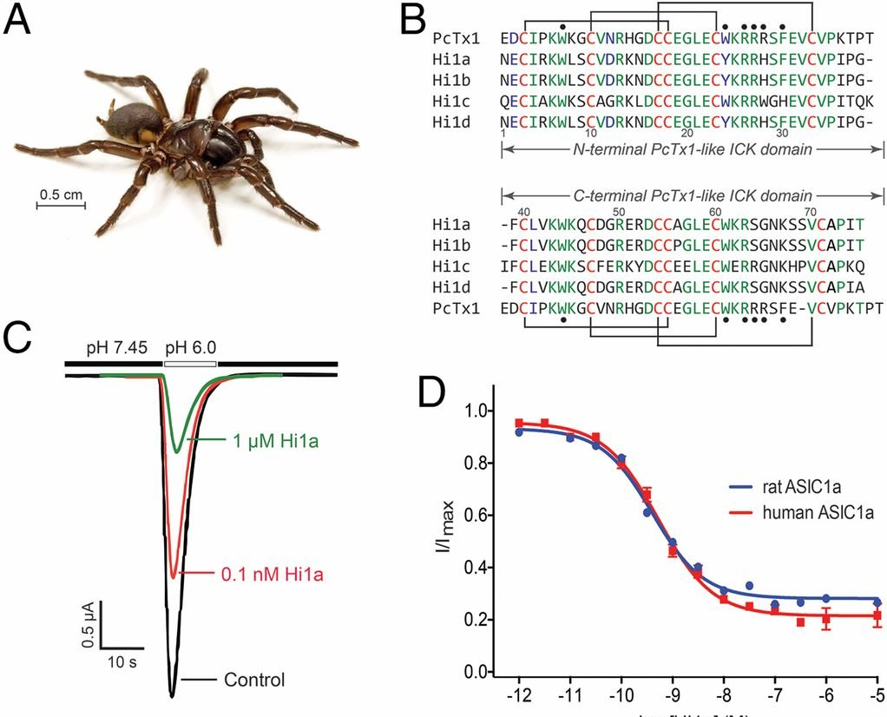
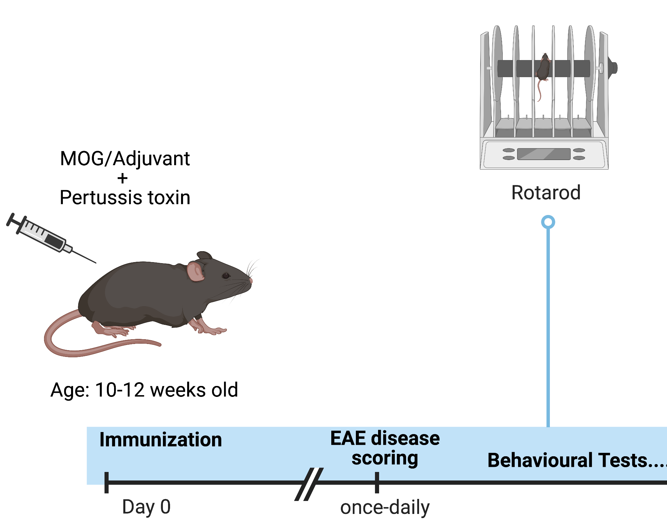
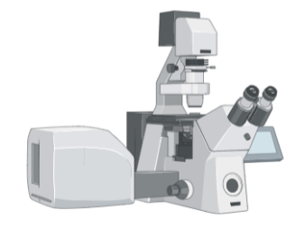
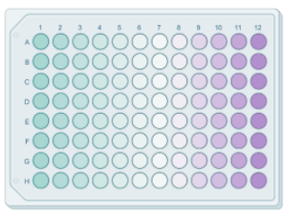
Hi1a – venom derived ASIC1 inhibitor
A novel, potent and selective ASIC1 inhibitor
Hi1a showed significant neuroprotective in a rat model of ischemic stroke.
Our Hypothesis:
Hi1a is neuroprotective in the EAE mouse model of MS
Hadronyche infensa
IC₅₀ values
Rat ASIC1a
400± 80 pM
Human ASIC1a
520 ± 60 pM
Chassagnon et al., PNAS 2017
Notes:
https://www.semanticscholar.org/paper/Venoms-to-Drugs%3A-Translating-Venom-Peptides-into-King/9e1a91559c033aa6b0d68649475a44adb8ddbc5b

Slide 6
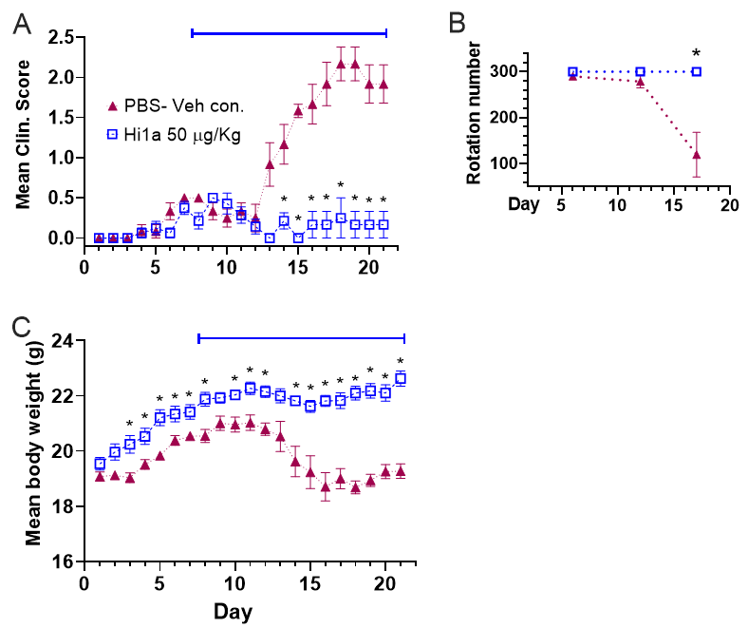
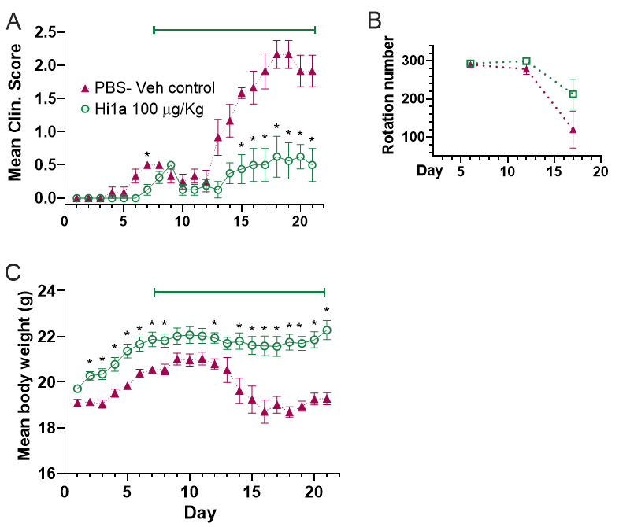
Hi1a significantly reduced EAE disease progression
ASIC1 is a promising druggable target to promote neuroprotection in MS
50 ug/kg /day
100 ug/kg /day
Un-published

Slide 7
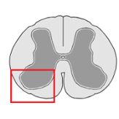
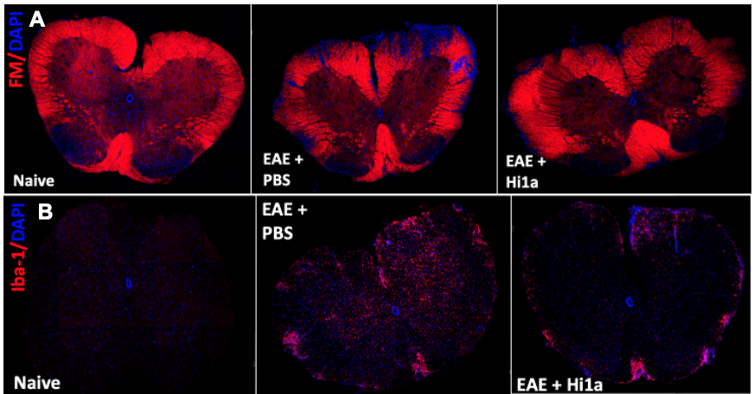
What does Hi1a do to the hallmarks of EAE/MS?
Hi1a decreases (1) myelin damage in the white matter, (2) cell infiltration, and (3) glial cells activation

Slide 8
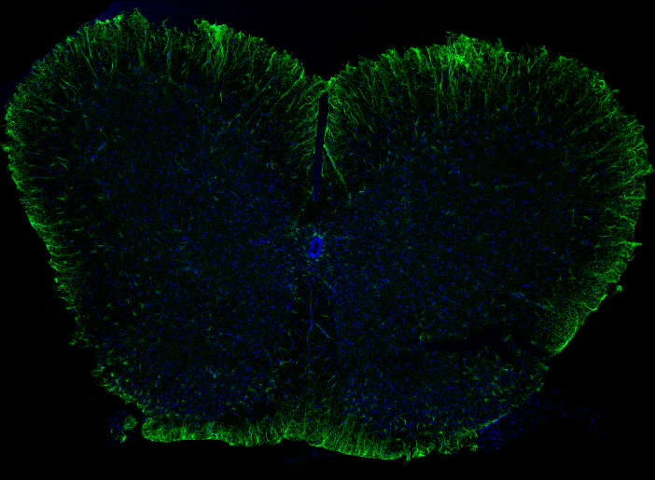
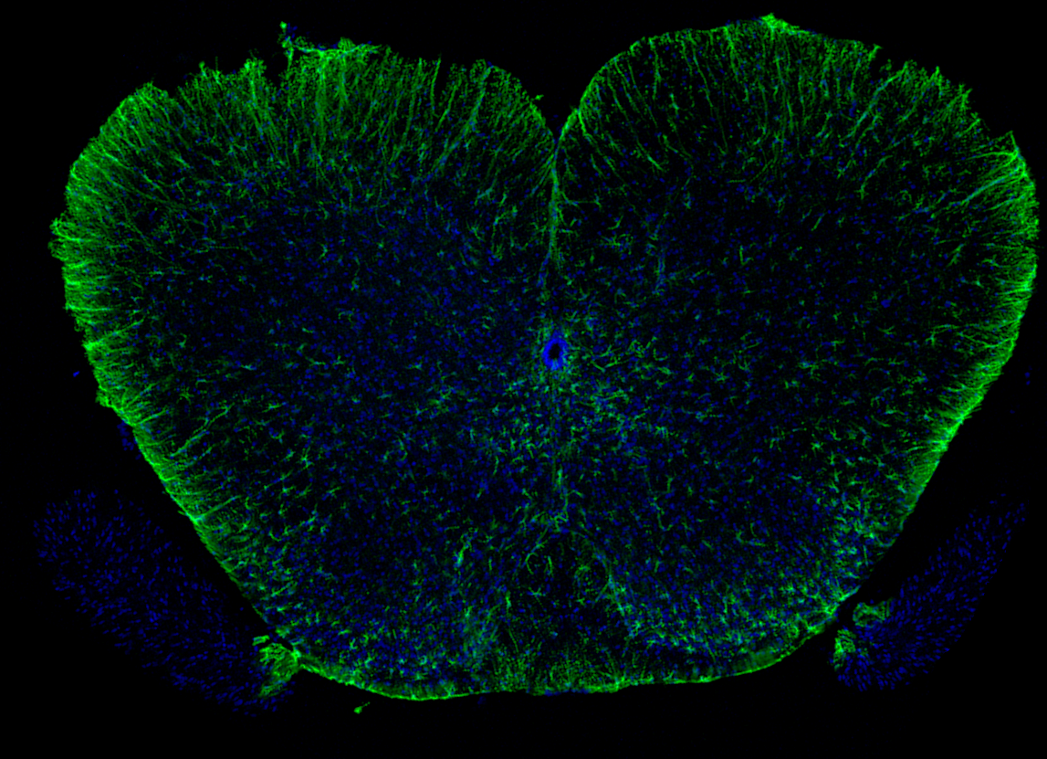
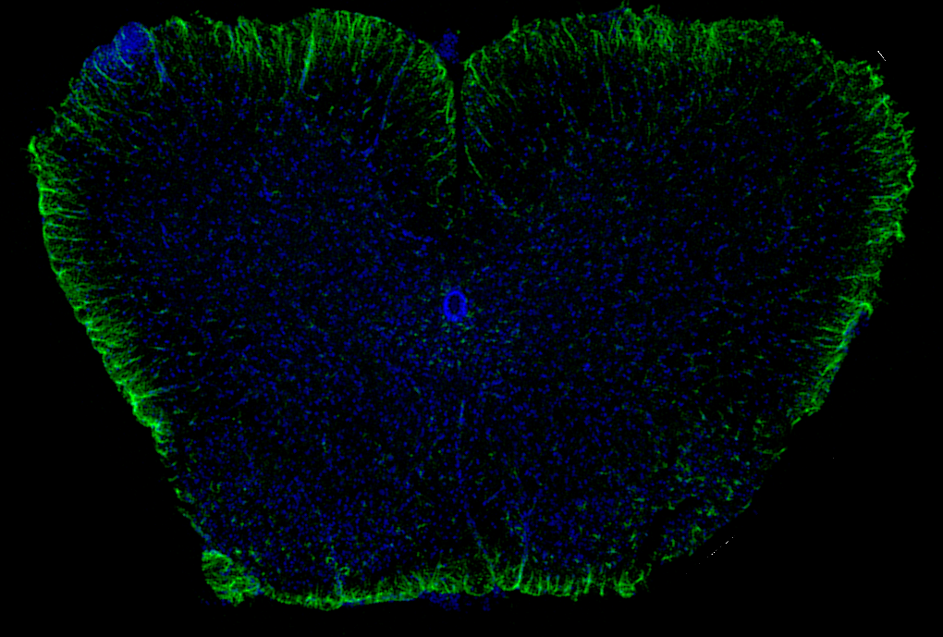
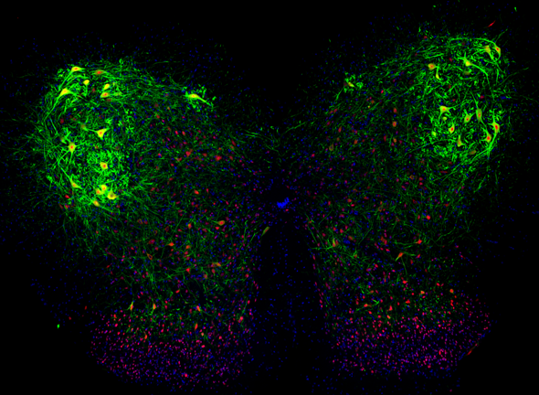
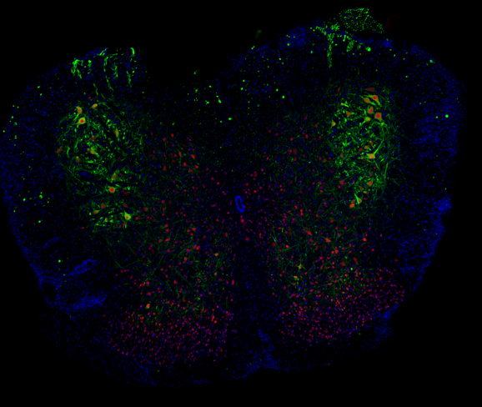
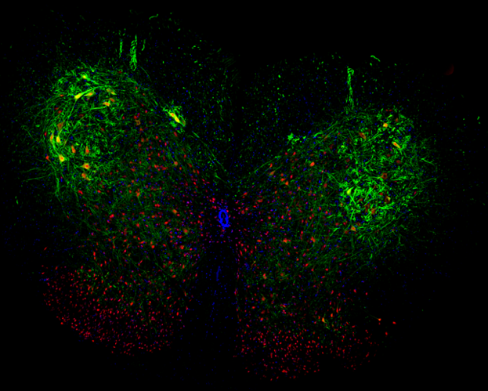
What does Hi1a do to the hallmarks of EAE/MS?
Hi1a decreases (1) myelin damage in the white matter, (2) cell infiltration, and (3) glial cells activation
Naive
EAE + PBS
HI1a (50 ug/kg)
NAIVE
EAE-PBS
EAE-HI1A
GFAP/DAPI
DAPI/NEUN/SMI32
Notes:
The monoclonal antibody SMI-32 recognizes an epitope present in NFs in the nonphosphorylated statw

Slide 9
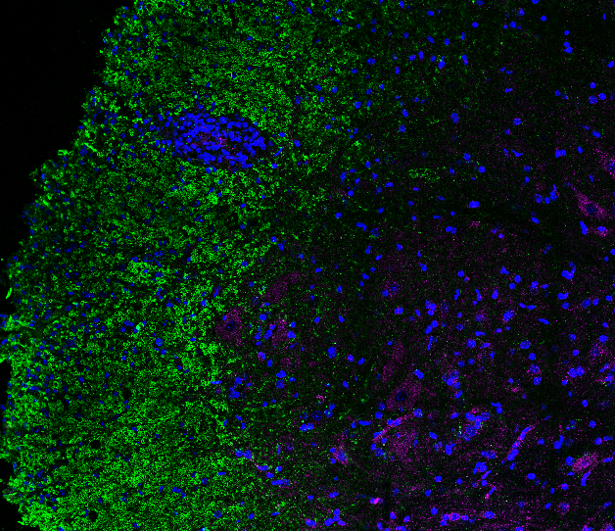
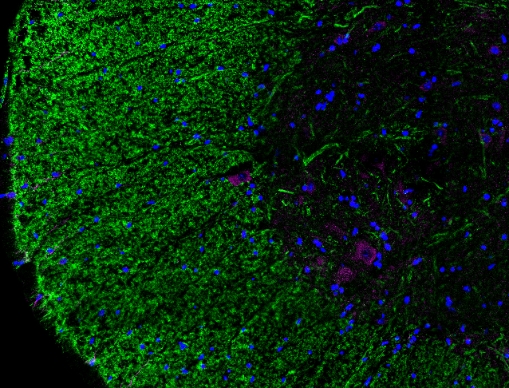
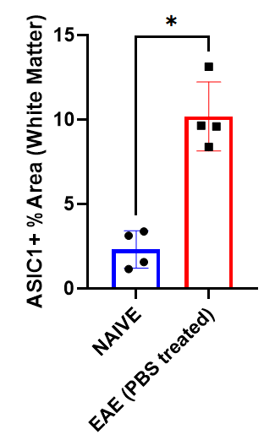
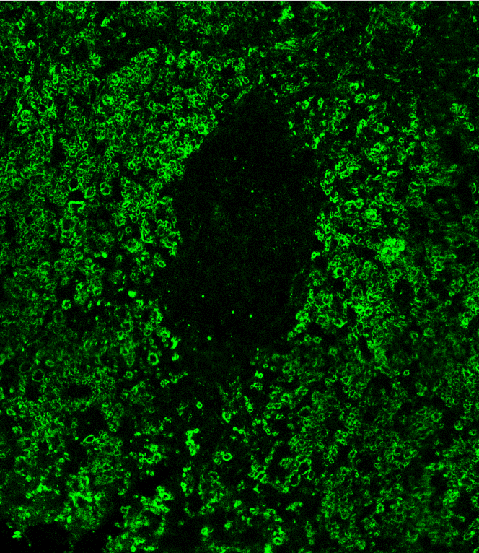
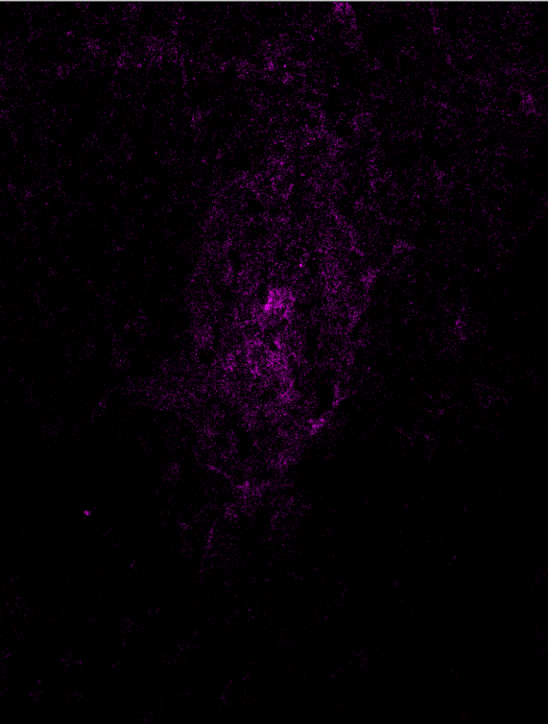
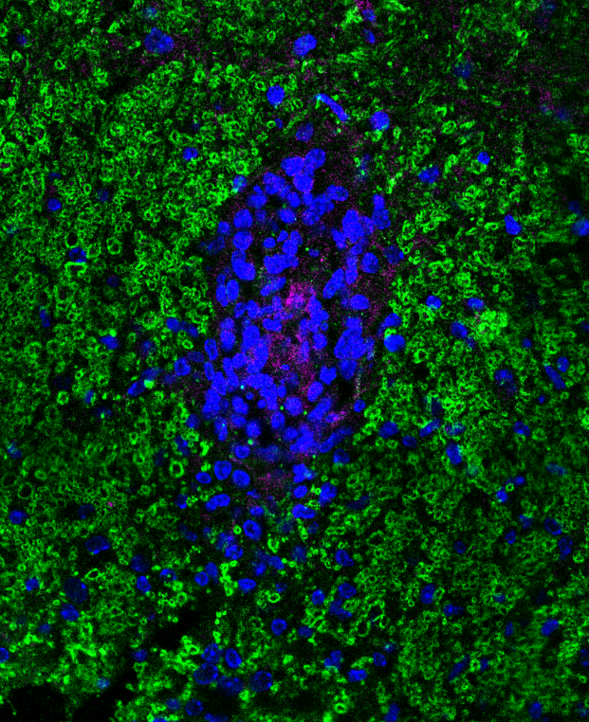
ASIC1a is present in active EAE lesions
ASIC1a appeared to be expressed by glial cells in addition to neuronal cells
ASIC1a/MBP
Naive
EAE + PBS
MERGED w/DAPI
ASIC1
MBP
NAIVE
CD68
EAE-PBS
EAE-HI1A
a
b
c
d
MERGED
CD68

Slide 10


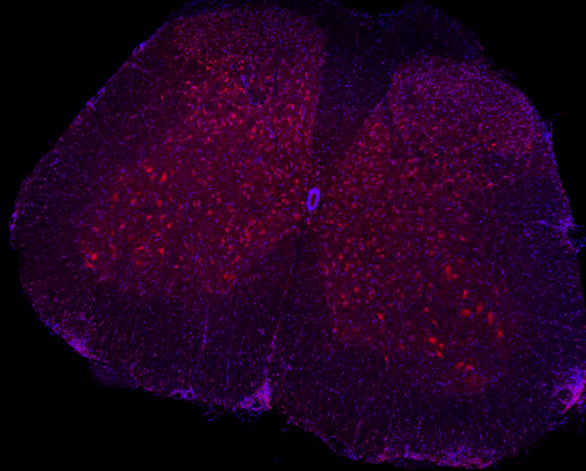
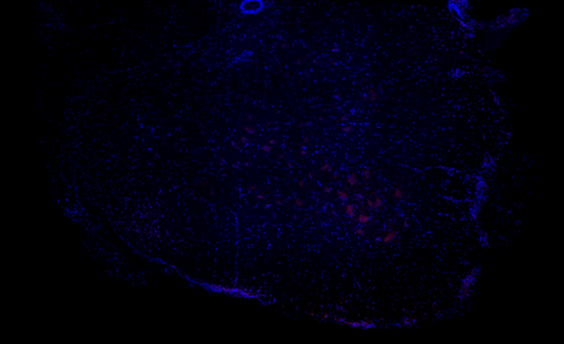
Does Hi1a get into the brain and spinal cord?
Hi1a was labelled with AF700 to track its distribution at CNS.
Hi1a-AF700 (~ 10 kDa) accesses damaged spinal cord and brain parenchyma, but not healthy CNS tissue.
DAPI
Hi1a-AF700
Hi1a-AF700 majorly binds to neuronal cell bodies

Slide 11
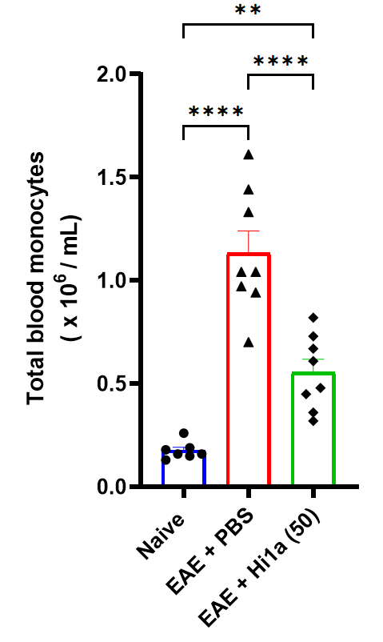
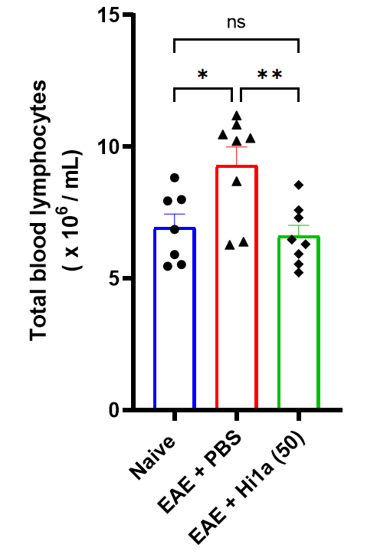
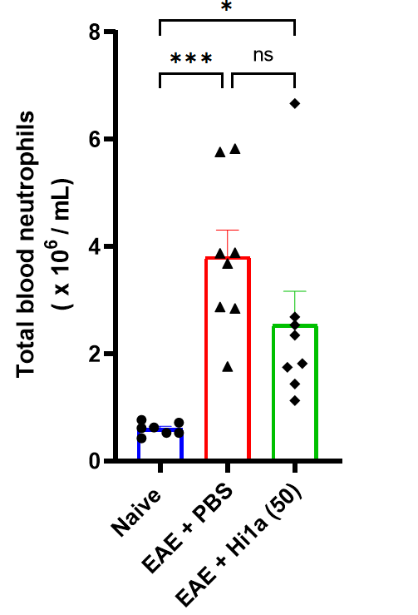
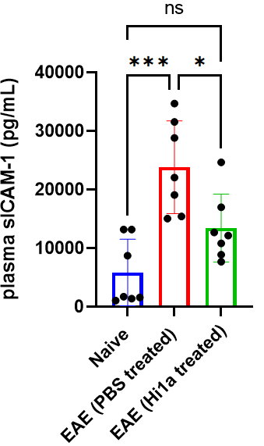
Hi1a impact on peripheral immune cells?
Peripheral immune cells also express ASIC1 but their functional role in EAE/MS is largely unexplored.
sICAM1 indicates vascular inflammation/BBB leakage
Un-published

Slide 12
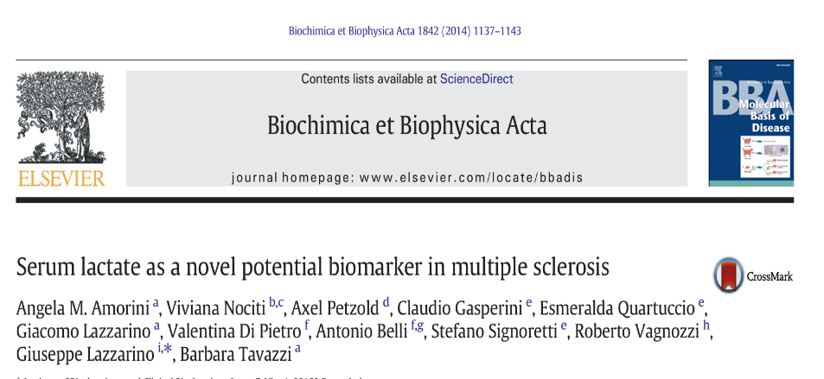
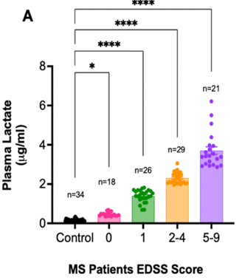
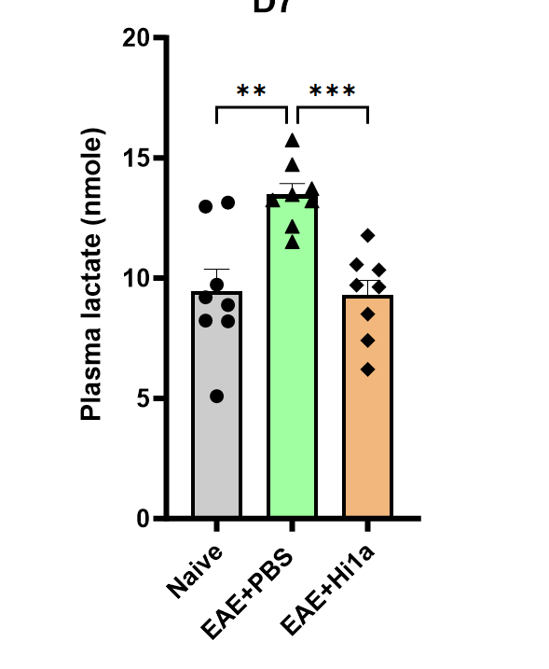
Serum Lactate – a biomarker of MS disease progression
Lactate is a potent activator of ASIC1a that can worsen neuronal damage.
B
Altered brain pH and lactate levels in CNS can trigger neurodegeneration.
RRMS patients showed increased plasma lactate levels corresponding to disease disability score.
Hi1a-treated EAE mice showed decreased plasma lactate
Notes:
Lactate in the brain has long been associated with ischaemia; however, more recent evidence shows that it can be found there under physiological conditions. In the brain, lactate is formed predominantly in astrocytes from glucose or glycogen in response to neuronal activity signals. Thus, neurons and astrocytes show tight metabolic coupling. Lactate is transferred from astrocytes to neurons to match the neuronal energetic needs, and to provide signals that modulate neuronal functions, including excitability, plasticity and memory consolidation. In addition, lactate affects several homeostatic functions.
L-Lactate
In the brain, the main source of L-lactate is astrocytic glycolysis from blood glucose, glycogen, and blood lactate

Slide 13
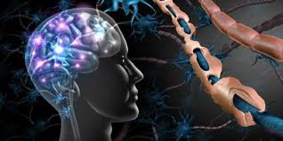
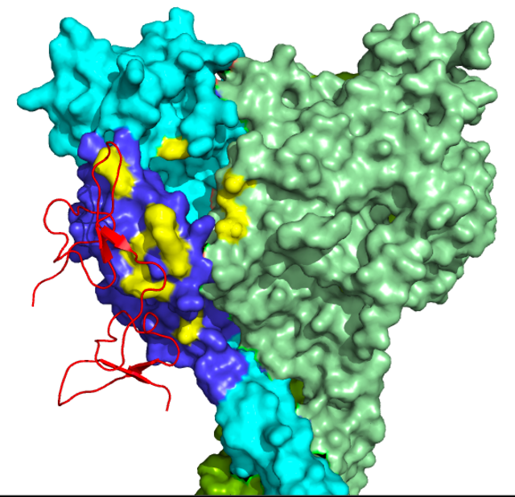
Summary & Future Directions
Acid-sensing ion channels (ASICs) represent a widely expressed pH sensor in CNS that plays a key role in neuroinflammation/neurodegeneration.
Hi1a, a potent blocker of ASIC1a, showed neuroprotection in the EAE mouse model. The exact MOA needs to be elucidated.
Further experiments are needed to validate the therapeutic efficiency of Hi1a in other animal models (e.g. cuprizone mouse model) of MS and ASIC1 KO mice.
In-vitro studies using OPCs/primary neuron culturing are needed to validate the direct neuroprotective role of Hi1a
Hi1a

Slide 14










Acknowledgements
Dr. Nemat Khan
Dr. Lachlan Rash
Prof. Pamela
McCombe
Em Prof. Maree Smith
Maleeha Waqar
Dr. Neville Butcher

Slide 15
Extras for QA

Slide 16
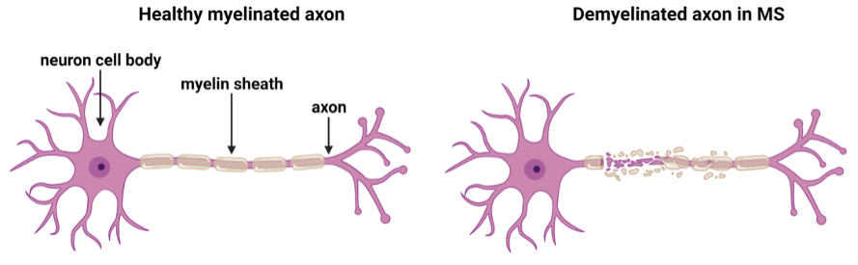
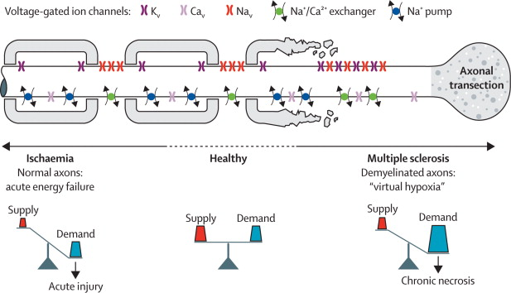
Multiple Sclerosis
Pathology 2
axonal degeneration correlates best with clinical deficits
- axonal degeneration by causing inflammation-induced neuronal mitochondrial dysfunction,
=> reduced ATP production = energy failure and alteration of ion-exchange mechanisms
- Increased Na+ and Ca2+ influxes, activate proteases and disrupt the cytoskeleton,
=> pathophysiology similar to ischemia
Increased lactate, decreased pH, lower extracellular Ca2+, extracellular protease activity
=> All increase ASIC1a function
Neurodegeneration: Hypoxia/acidosis
Stys, 2004
Notes:
The axonopathy associated with MS has been one of the central focuses of understanding the disease, and its association with variability in cases and disease courses. The most important function of myelin sheath is saltatory conduction, which is fast and insulated conduction of neuronal electrical signals. The demyelination can trigger responses in the axon’s distribution of ion channels, which can in part restore the conduction. However, the major issue remains that with the damaged myelin, the axon can no longer do saltatory and fast conduction but do more continuous and slow conduction. There is ion channel redistribution on the axons to restore this conduction. Among these are voltage gated sodium channels (Nav), and their redistribution has been linked to axonal injury. In healthy neurons, there is an equal supply of ATP for the demand during action potential generation. But in MS, the channel redistribution causes an increase in the ATP demand. This creates an energy deficit which affects the functioning of Na/K ATPase pump, resulting in high intracellular Na+ and high extracellular Ca+. The Ca+ increase in extracellular space reverses the polarity of the Na+/ Ca+ exchanger leading to an increased influx of Ca+ which will then trigger Ca+ dependent proteases that further damage the axon cytoskeleton.
Preceding mitochondrial dysfunction contributes to this degeneration as well. Increased activated microglia and macrophage infiltration can release reactive oxygen species and nitric oxide, which can inhibit mitochondrial respiration, resulting in hypoxia, which continues the vicious cycle of increased conduction failure, and further axonal damage.

Slide 17

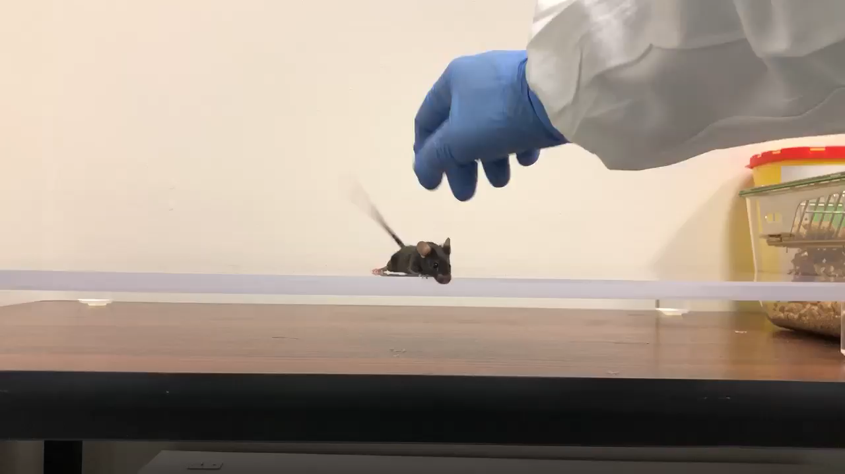
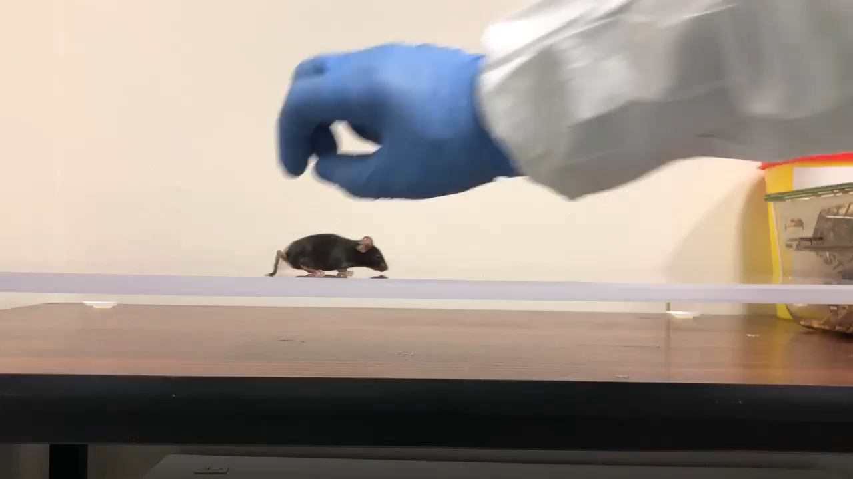

EAE disease – scoring (Grade 1-5)
Scoring EAE Mice
Score 0
Score 1
Score 2
Score 3
Notes:
https://www.uspharmacist.com/article/current-perspectives-on-multiple-sclerosis
http://moderndayms.com/2015/11/the-four-types-of-multiple-sclerosis/

Slide 18
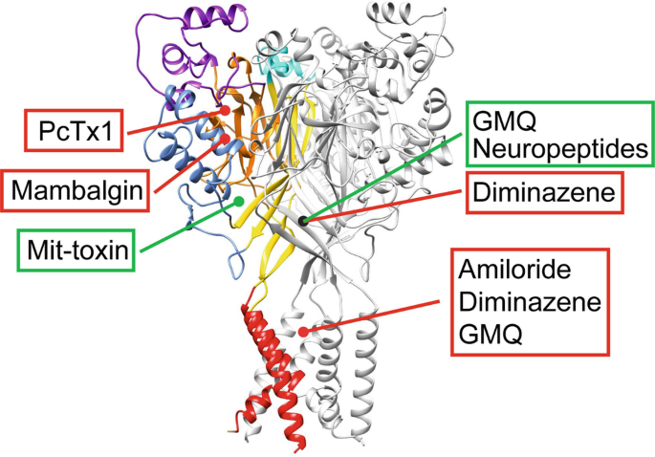
Hi1a

